Slide 1
NBA Data Science Project
David Au
INFO 450

Slide 2
Problem
NBA is growing too large and is considering adding 2 expansion teams. These new teams need marketable players to become the face of the franchise, but how do they know who to draft?
The Big Question
How do NBA scouts know which NCAA players to draft to maximize their franchise’s revenue?
Notes:
Why are you working on this project?

Slide 3



Benefits
Notes:
What is the benefit?

Slide 4
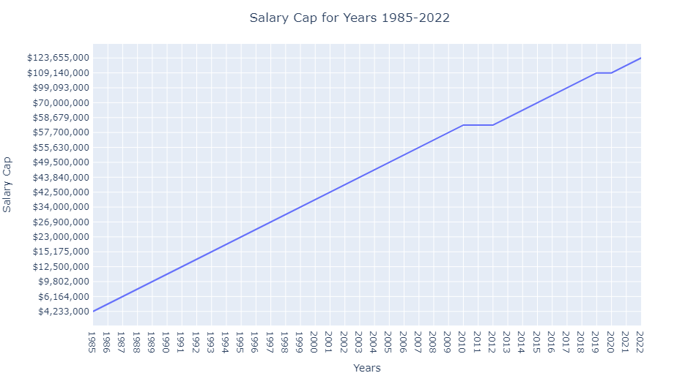
NBA Growth

Slide 5
Methodology
Comparing past athletes’ points per game to the Class of 2021
Comparing past athletes’ efficiency to the Class of 2021
Comparing different programs/colleges
Notes:
How did you break the problem down?
What tools did you use?
What challenges did you overcome?

Slide 6
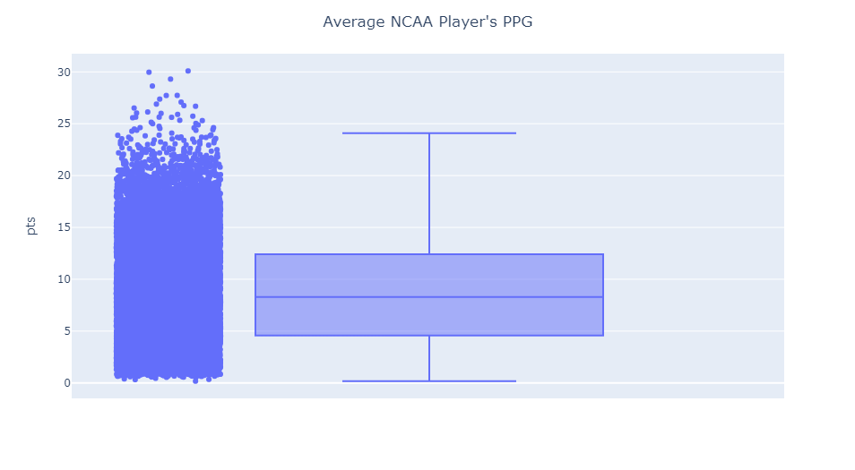
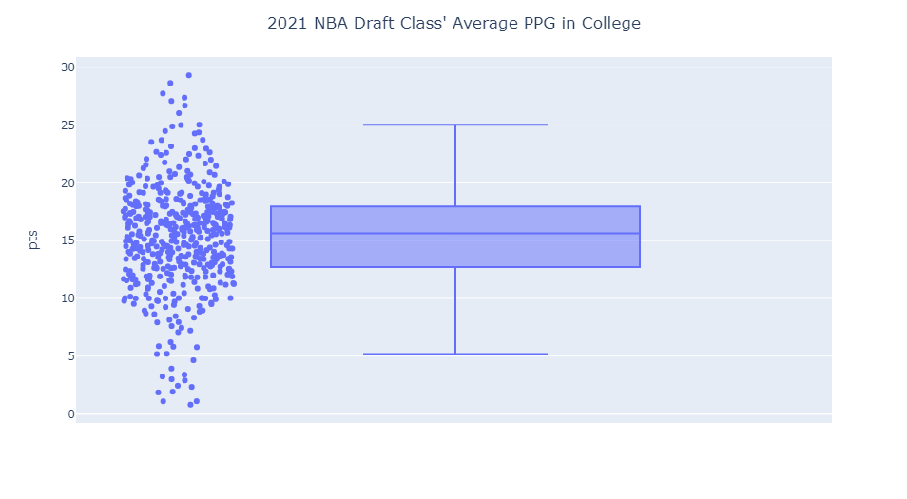
Comparing Points
Median: 8.29
Q1: 4.57
Q3: 12.41
Median: 15.64
Q1: 12.71
Q3: 17.95

Slide 7
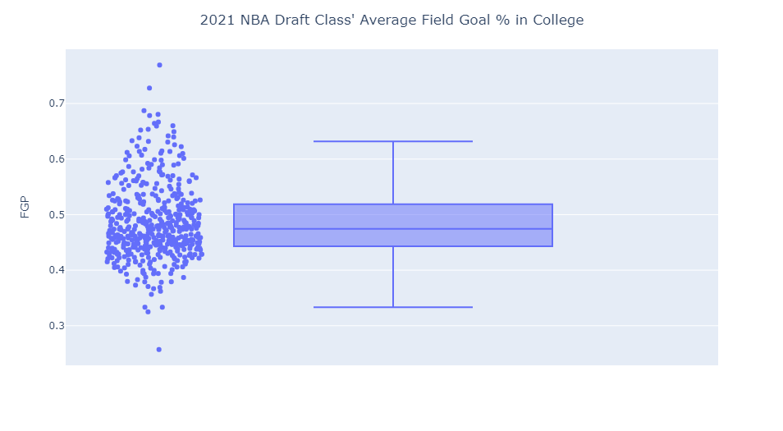
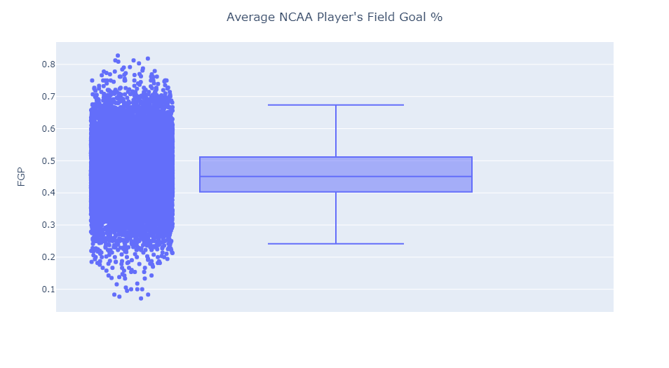
Comparing Efficiency
Median: 47.45
Q1: 44.30%
Q3: 51.88%
Median: 45.13%
Q1: 40.32%
Q3: 51.15%

Slide 8
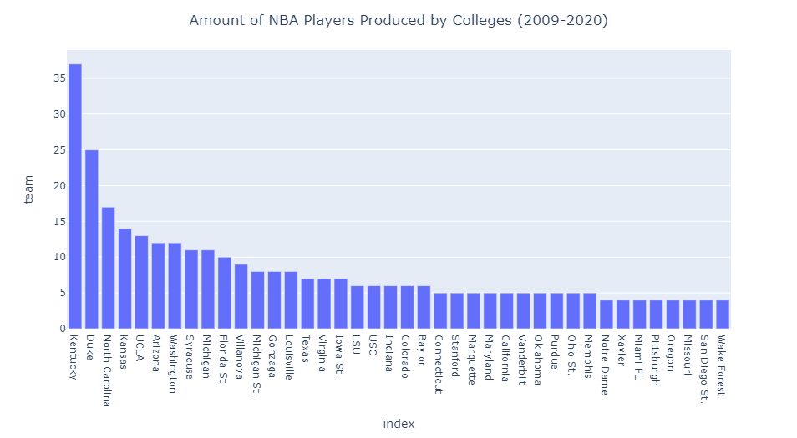
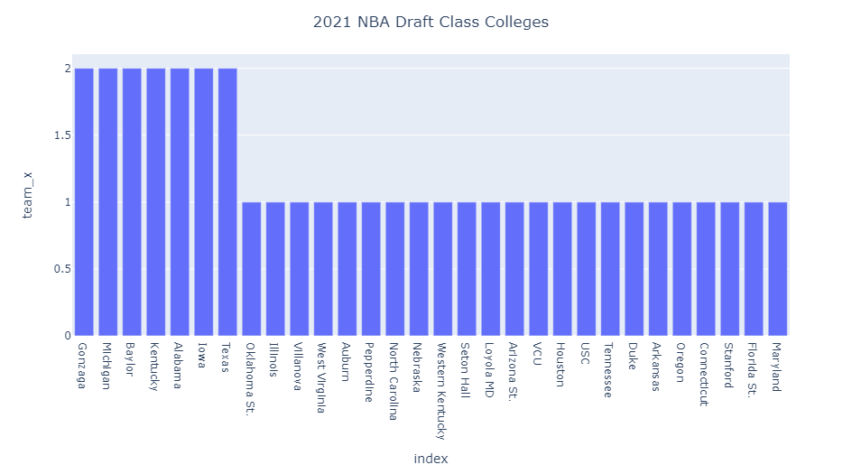
Compare Programs

Slide 9
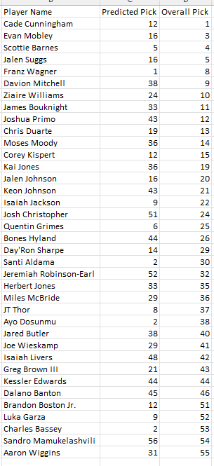

Findings & Insights
Hypothesis:
More efficient players were more likely to be drafted/drafted higher.
10.27% - too low
100% - too high/perfect
Notes:
What new things did you discover?
Were you able to support existing theories using statistics?
How did you machine learning model perform?

Slide 10
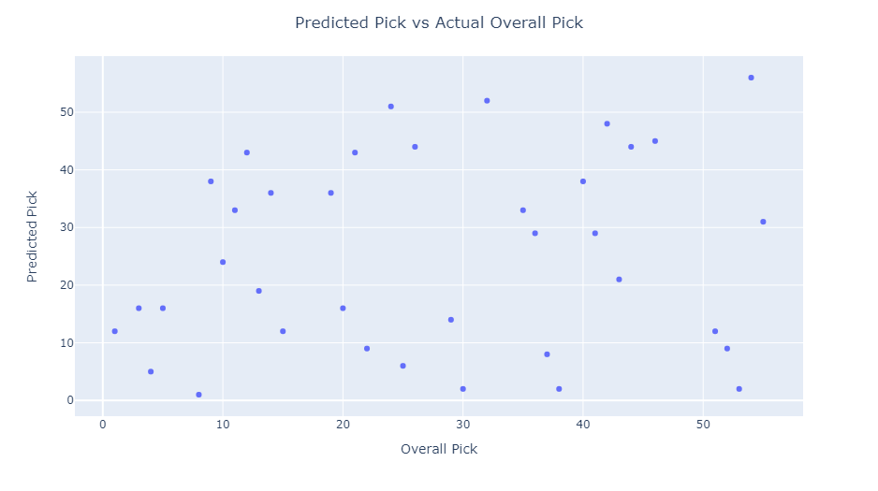
Compare Predicted vs Actual

Slide 11
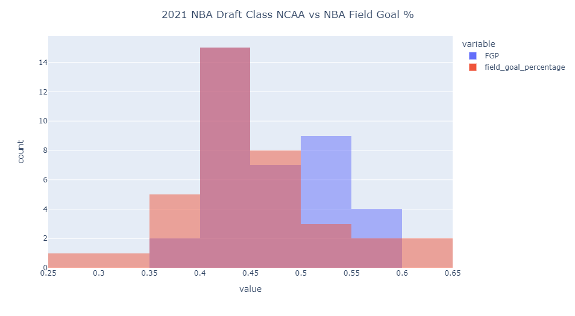
Transition

Slide 12

Recommendations
Higher Average PPG/Higher Average FG%/Programs
Logistic Regression/Decision Tree Machine Learning Models
$$<$$

Slide 13



Proposed Future Work
Gather More Data
Points/Efficiency ≠ Value in NBA
Look at more advanced statistics
Ex. +/-, VORP (Value over Replacement Player), Win Shares/48
Alternative Leagues
NBA G-League Ignite
EuroLeague
Ligue Nationale de Basketball Pro A (LNB Pro A)
High School Data
One-and-Done Rule
Notes:
What are the next steps?
Does this problem need to be revisited in the future?
Can the project be improved with more work?

